Slide 1

MindCareAI Project
Project By: Mohammed Yahya Md Badruddin Hisham Khuram Mohammad Ahmed Raza Sofi

Slide 2

Introduction
This presentation outlines the MindCareAI Project, focusing on user management and the journal feature that support mental health, using the Gemini AI.
• Mental health is a growing concern globally.
• Early detection and support are crucial.
• MindCare-AI leverages AI to assist in mental health care.

Slide 3
User Management
User Login: The User Login page allows secure access to the platform. It features a username and password entry with safety measures.
User Registration: The User Registration process is simple and user-friendly, enabling new users to create accounts quickly and efficiently.

Slide 4
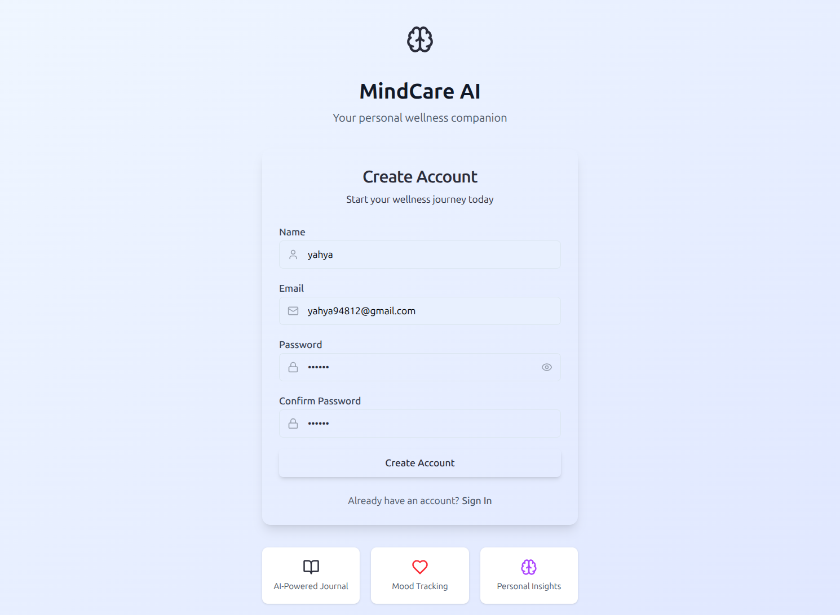

Slide 5
Journal Feature
Users can log their feelings and goals for the day. This promotes mindfulness and sets a positive tone.

Slide 6
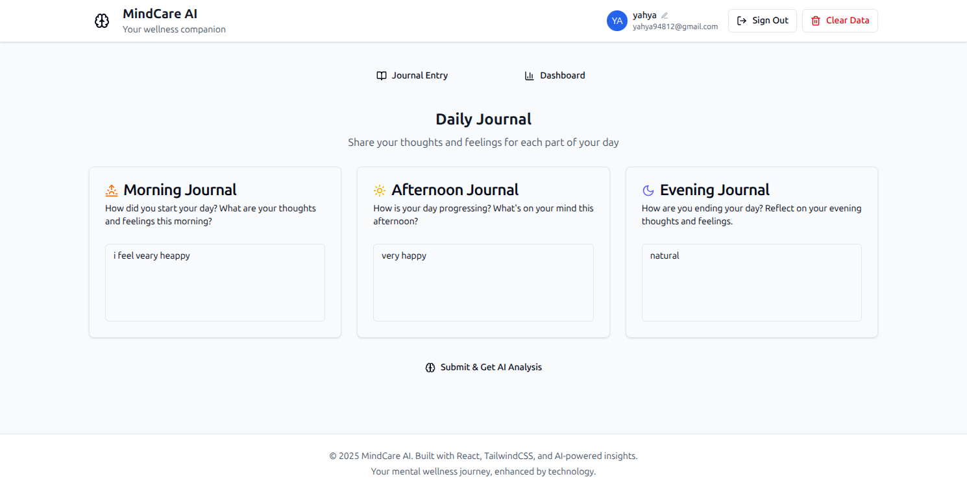

Slide 7
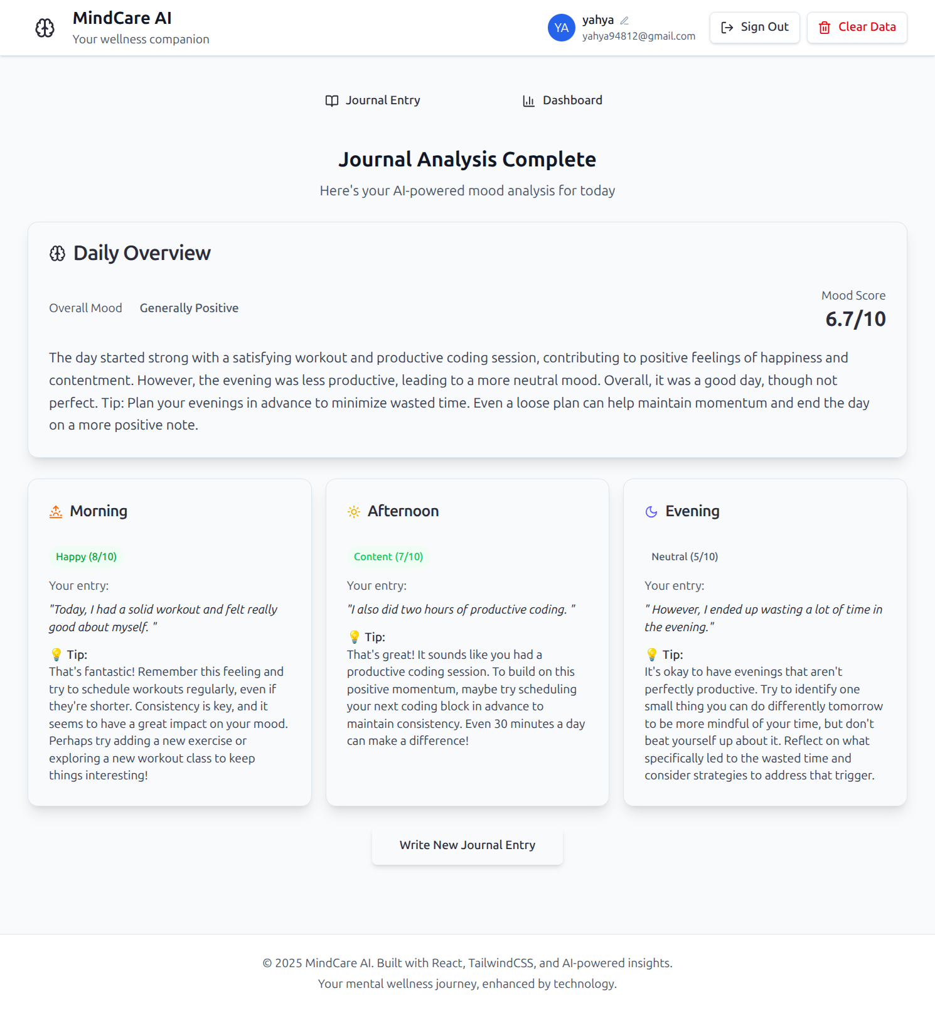

Slide 8
Dashboard Overview
The dashboard displays mood scores out of 10, providing a quick overview of users' emotional well-being.

Slide 9
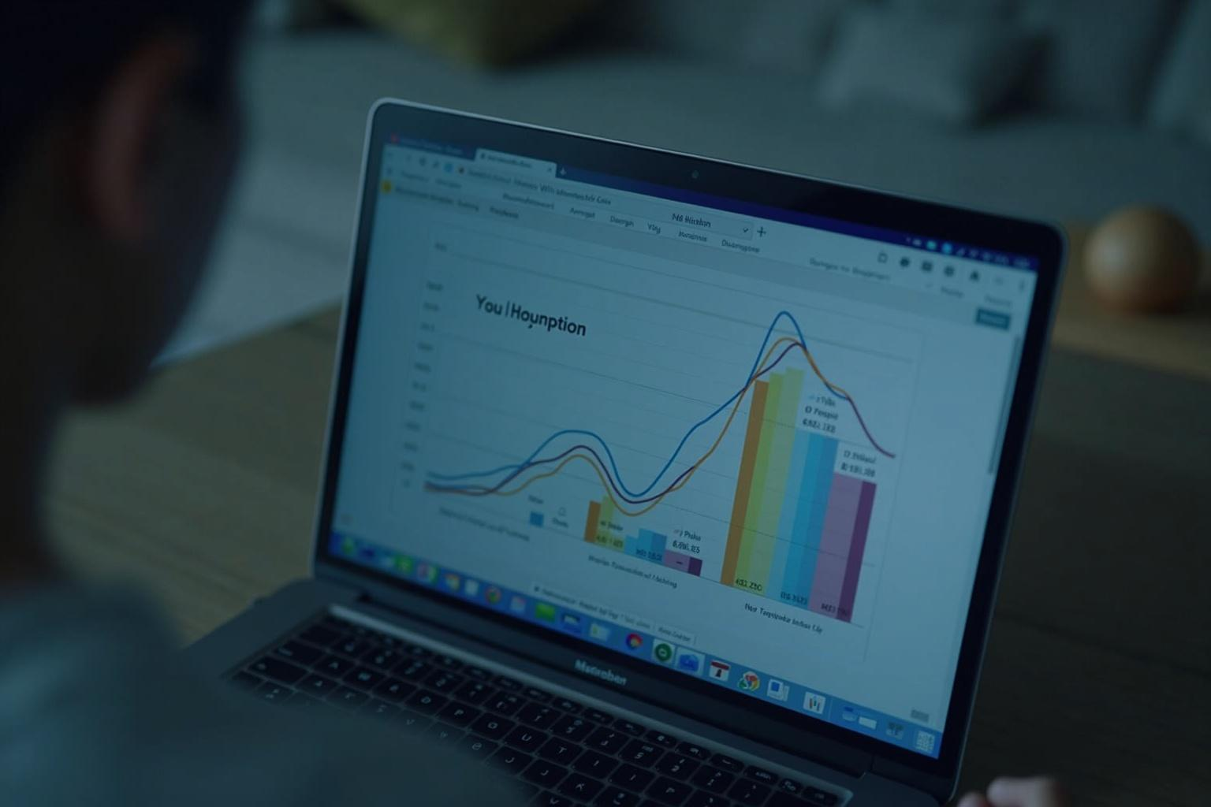
Mood Comparison Graph
Users can compare mood scores throughout the day, identifying trends and triggers in their emotional states.

Slide 10
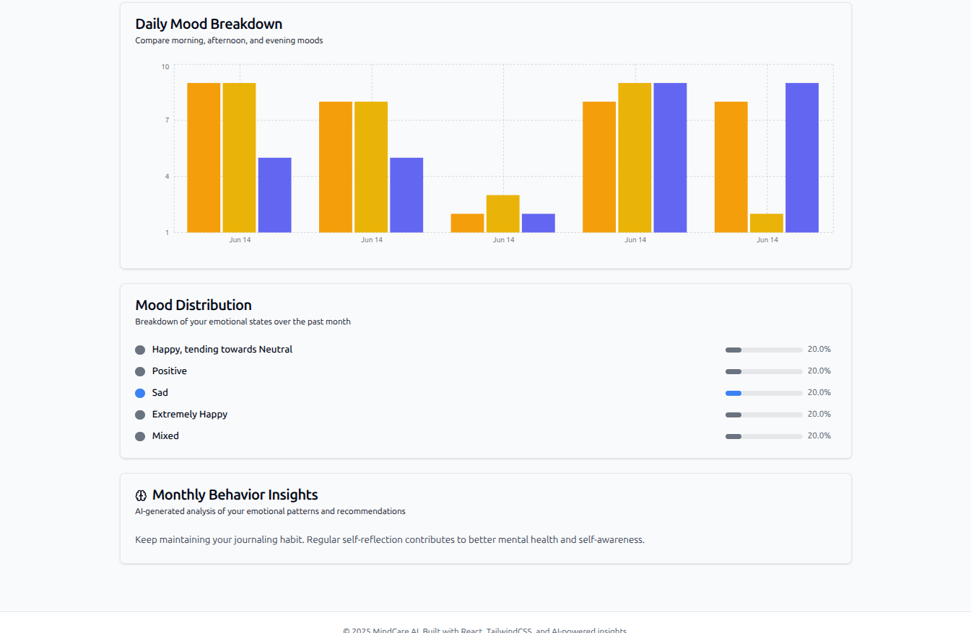

Slide 11
Daily Mood Trends
This feature tracks mood scores over time, helping users recognize patterns and make informed decisions about their mental health.

Slide 12
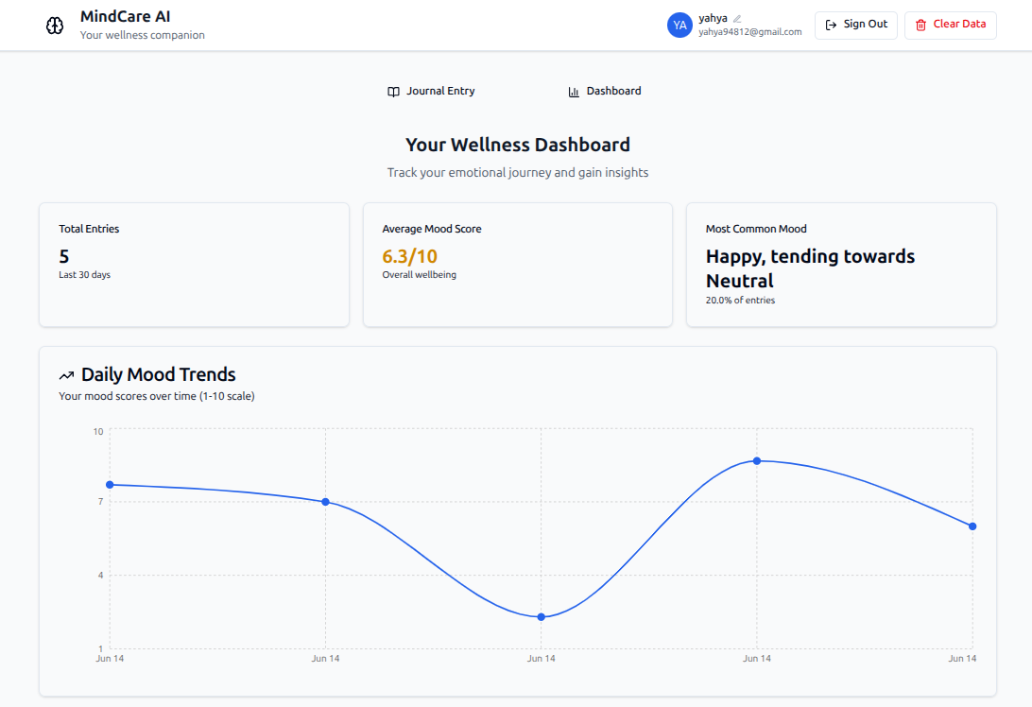

Slide 13
Conclusions
MindCareAI offers essential tools for users to monitor and enhance their mental well-being through structured entries and insights.

Slide 14
Thank You

